Slide 1
Final Course Project
Your CV on the Blockchain

Slide 2
Why?
Be present with your knowledge directly on the blockchain
Beyond a course certificate
Showcase your knowledge
Eventually get hired or be a consultant

Slide 3
How?
Make this final project on your own
Submit the project to the CV Contract (shown later)

Slide 4
What do you have to do?
It should showcase what you learned
Solidity
Imports
Truffle
Tests!
Web3
MetaMask or MIST

Slide 5
We have something prepared
We have an abstract contract prepared
Include this contract in your own and extend it
It contains 4 functions
getTitle()
getDescription()
getAuthor()
getAddress()

Slide 6
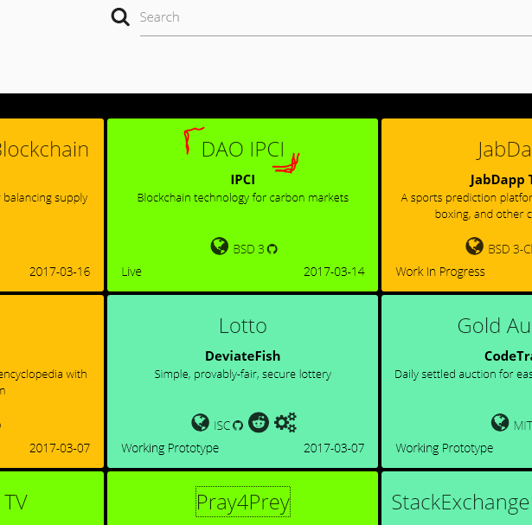
getTitle()
Should return the title of your app
Have a look at http://dapps.ethercasts.com/
No longer than 50 chars!

Slide 7
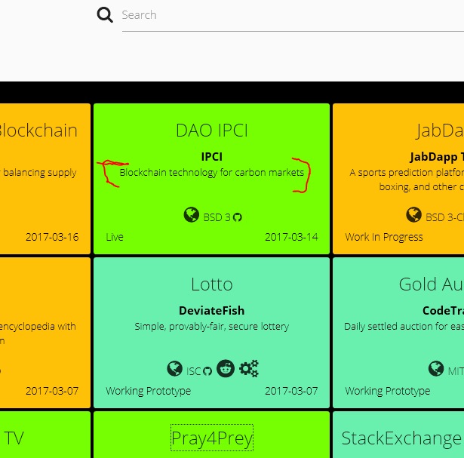
getDescription()
Should be a short description what your Dapp is about
No longer than 120 chars

Slide 8
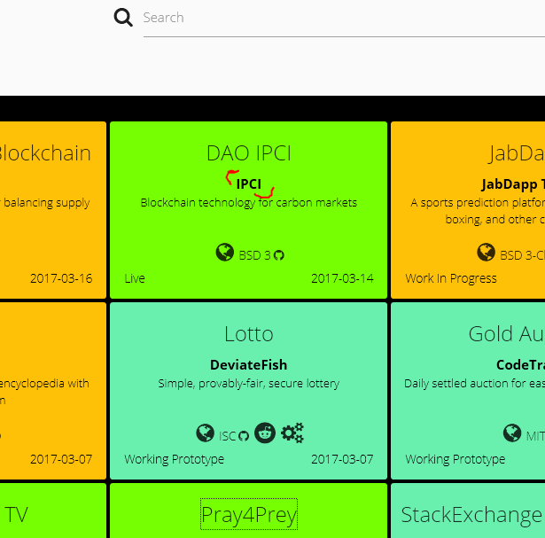
getAuthor()
Is all about you.
Return your name and some contact information
Name should be no longer than 50 chars

Slide 9
getAddress()
Returns the link to a sample page.
Github.io will do!

Slide 10
What should the Dapp be?
You are free to choose!
Must be legal though!
Suggested contract:
Your CV!
Add functions to add your own projects
Add functions to add education, knowledge, etc
Write a frontend!
We look for tests, javascript frontend, mist and metamask.
It should run on the live-chain!
It doesn‘t need to be complicated

Slide 11
Example
Contract MyContract is CVExtender, owned {
Struct Projects{
String name;
String description;
String url;
}
Mapping…
Function getProject(uint project_id) const returns(string name, …) {…}
…
}

Slide 12
How long will it take me?
Depends!
Contracts and Testing
Probably anywhere between 1 and 3 days
JavaScript and Design
Probably anywhere additionally between a few hours and days

Slide 13
Why should I do this?
Blockchain jobs are extremely lucrative
Have a place to showcase your work
We will actively try to promote it with companies
Or…
Just for fun and to strengthen your knowledge!

Slide 14
Get started
Right now!

